Slide 1
Flying Drones with Gestures
Laleh Safari | Pascal Schambach | Christian Wegmann

Slide 2
Agenda
1 |
Introduction and fundamental concepts
2 |
System Components
3 |
Data And Prediction Model
4 |
Live Demo
5 |
Conclusion

Slide 3
Agenda
1 |
Introduction and fundamental concepts
2 |
System Components
3 |
Data And Prediction Model
4 |
Live Demo
5 |
Conclusion

Slide 4
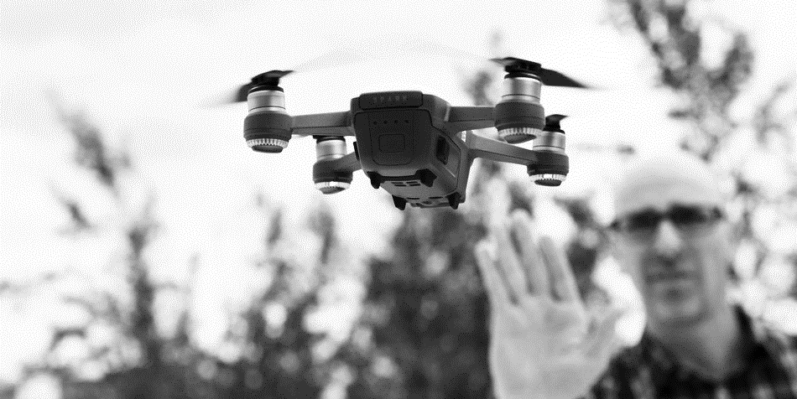
DRONE STEERING: A USE CASE OF GESTURE RECOGNITION

Slide 5
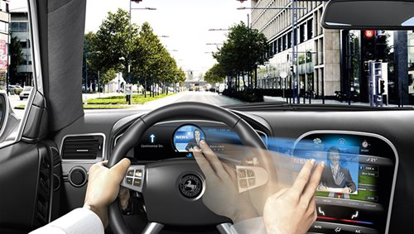

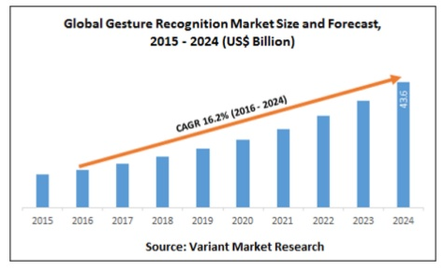
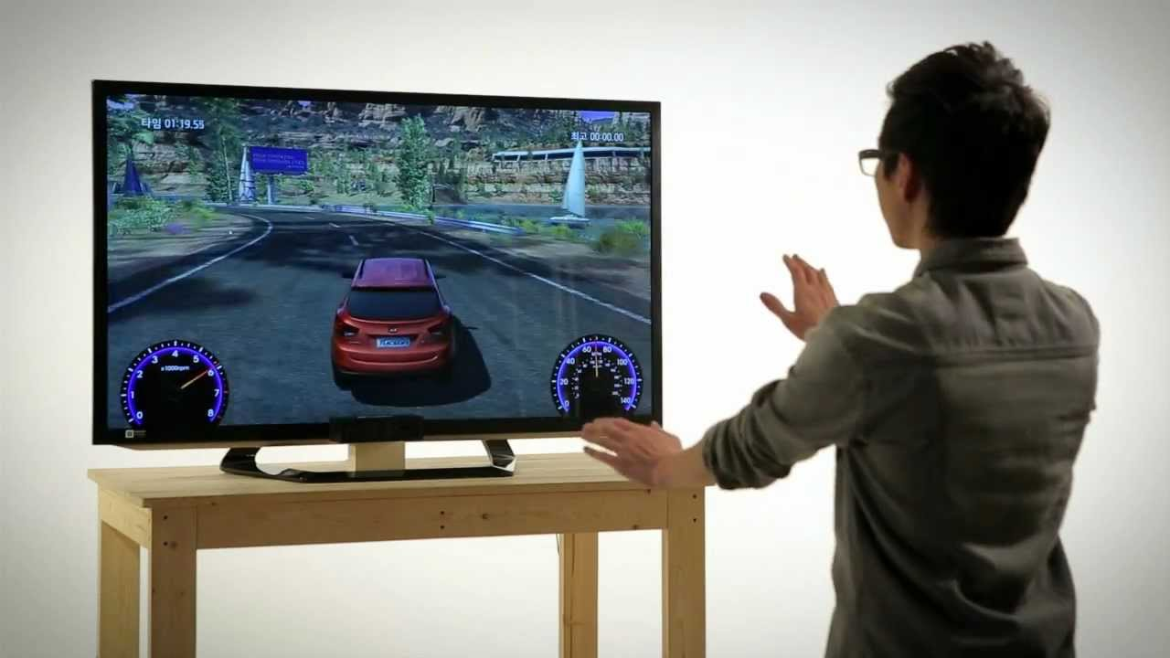
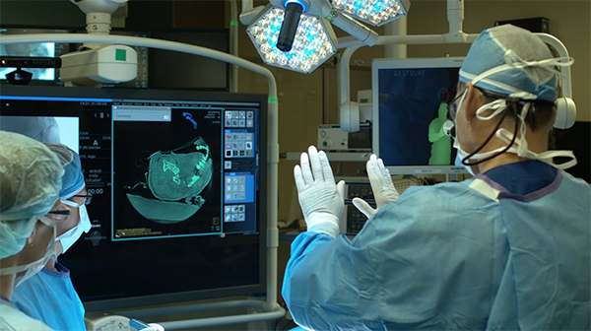
GESTURE RECOGNITION USE CASES
Gesture recognition technology can be integrated in perceptual user interfaces.
It can refer to any non-verbal communication that is intended to communicate a specific massage.
The global gesture recognition market is estimated to triple by 2024.
Car onboard system
Media use
Gaming
Medicine

Slide 6
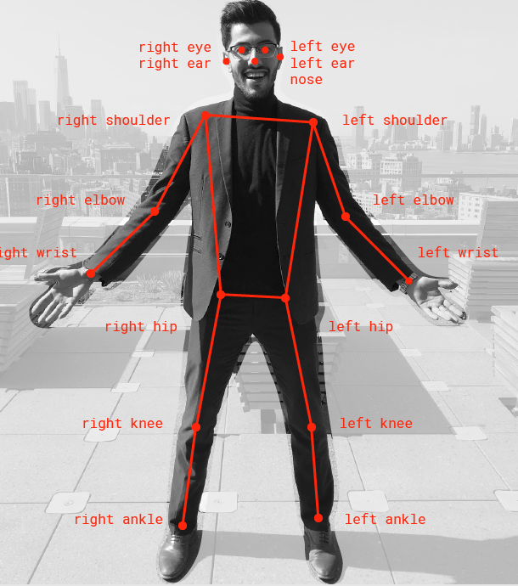
POSTURE (STATIC)
Postures is an image consist of x/y coordinates of human body joints.
Since a posture is static it is simple to handle and live predictions are faster. A posture can be used as simple command in perceptual user interfaces.
Label = right
features = x_{i} ,y_{i} , i = body joints

Slide 7
POSTUREs (Seven Classes)
STOP
take_off
move
flip
left
right
land
We classified everything which does not match exactly one of the above postures as ‘no posture’.

Slide 8
GESTURE (DYNAMIC)
On the other hand, a gesture is a sequence of postures.
Gestures allow us to be much more expressive (e.g. sign language of the deaf) than with postures – but it also more difficult to detect and interpret.
t₀
t₁
t₂
t₃
t
t
Label = right
Features = x_{i} , y_{i} , t_{i} , i = body joints

Slide 9
GESTURES (Seven CLASSES)
take_off
id=1
left
id=4
LAND
land
id=6
right
id=5
move
id=2
flip
id=3
We classified everything which does not match exactly one of the above gesture as ‘no gesture’.

Slide 10
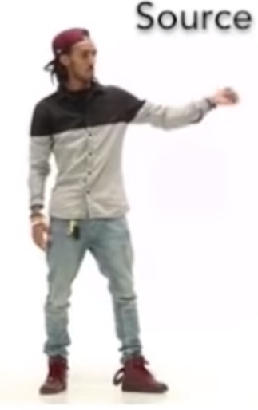
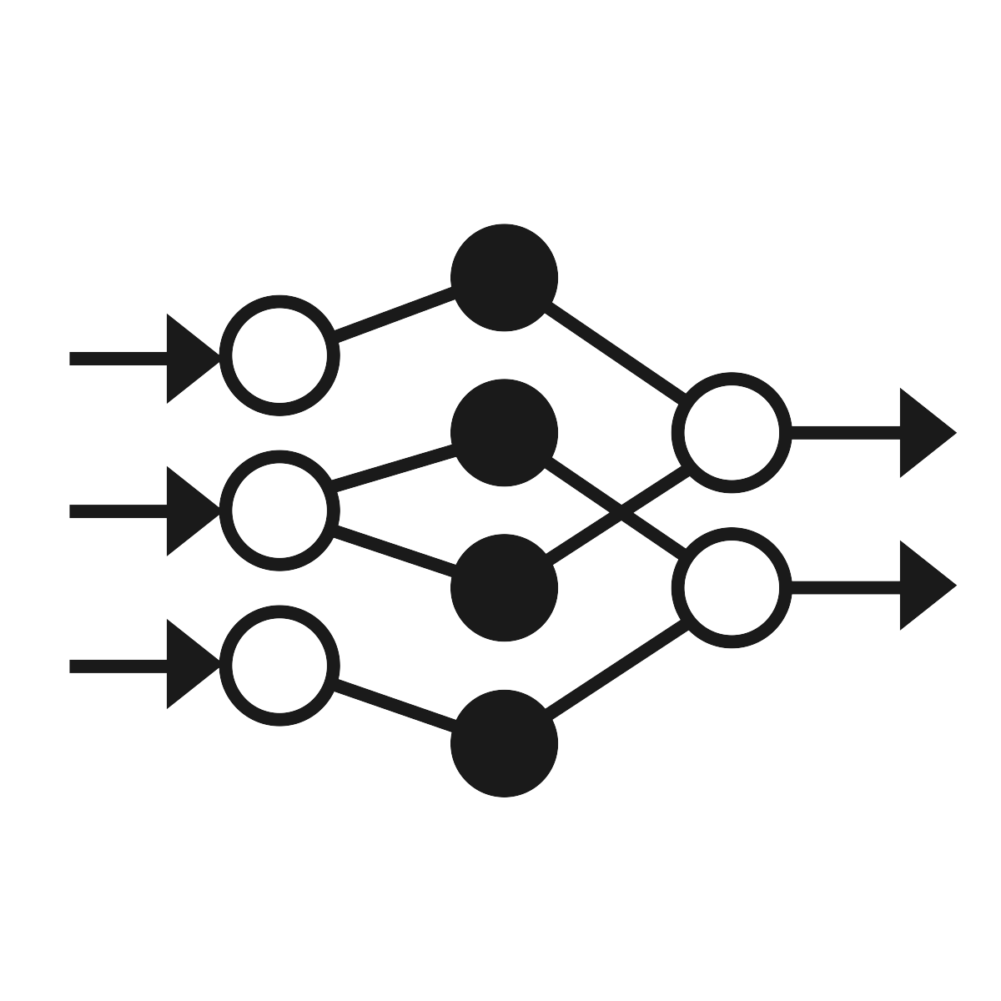


POSENET
In May 2018 the Google Creative Lab released a tensorflow.js version of PoseNet (see blog post). PoseNet is a convolutional neural network which in essence extracts the x/y coordinates of body parts from an input picture or video.
PoseNet
Video
Wireframe

Slide 11
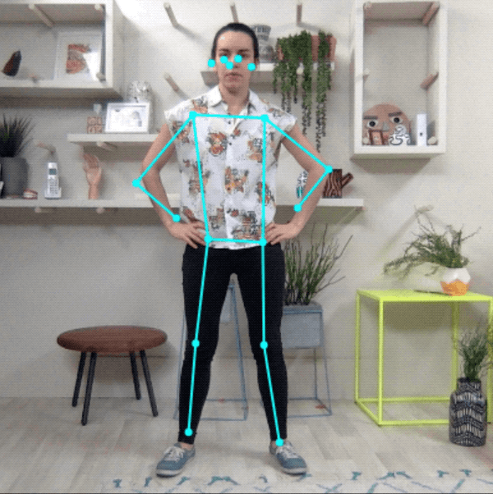
POSENET
In May 2018 the Google Creative Lab released a tensorflow.js version of PoseNet (see blog post). PoseNet is a convolutional neural network which in essence extracts the x/y coordinates of body parts from an input picture or video.
PoseNet
Video
Wireframe
…and this is how it looks:
We did a form of transfer learning by building our gesture detection model on top of the PoseNet output, i.e. the body part coordinates.

Slide 12
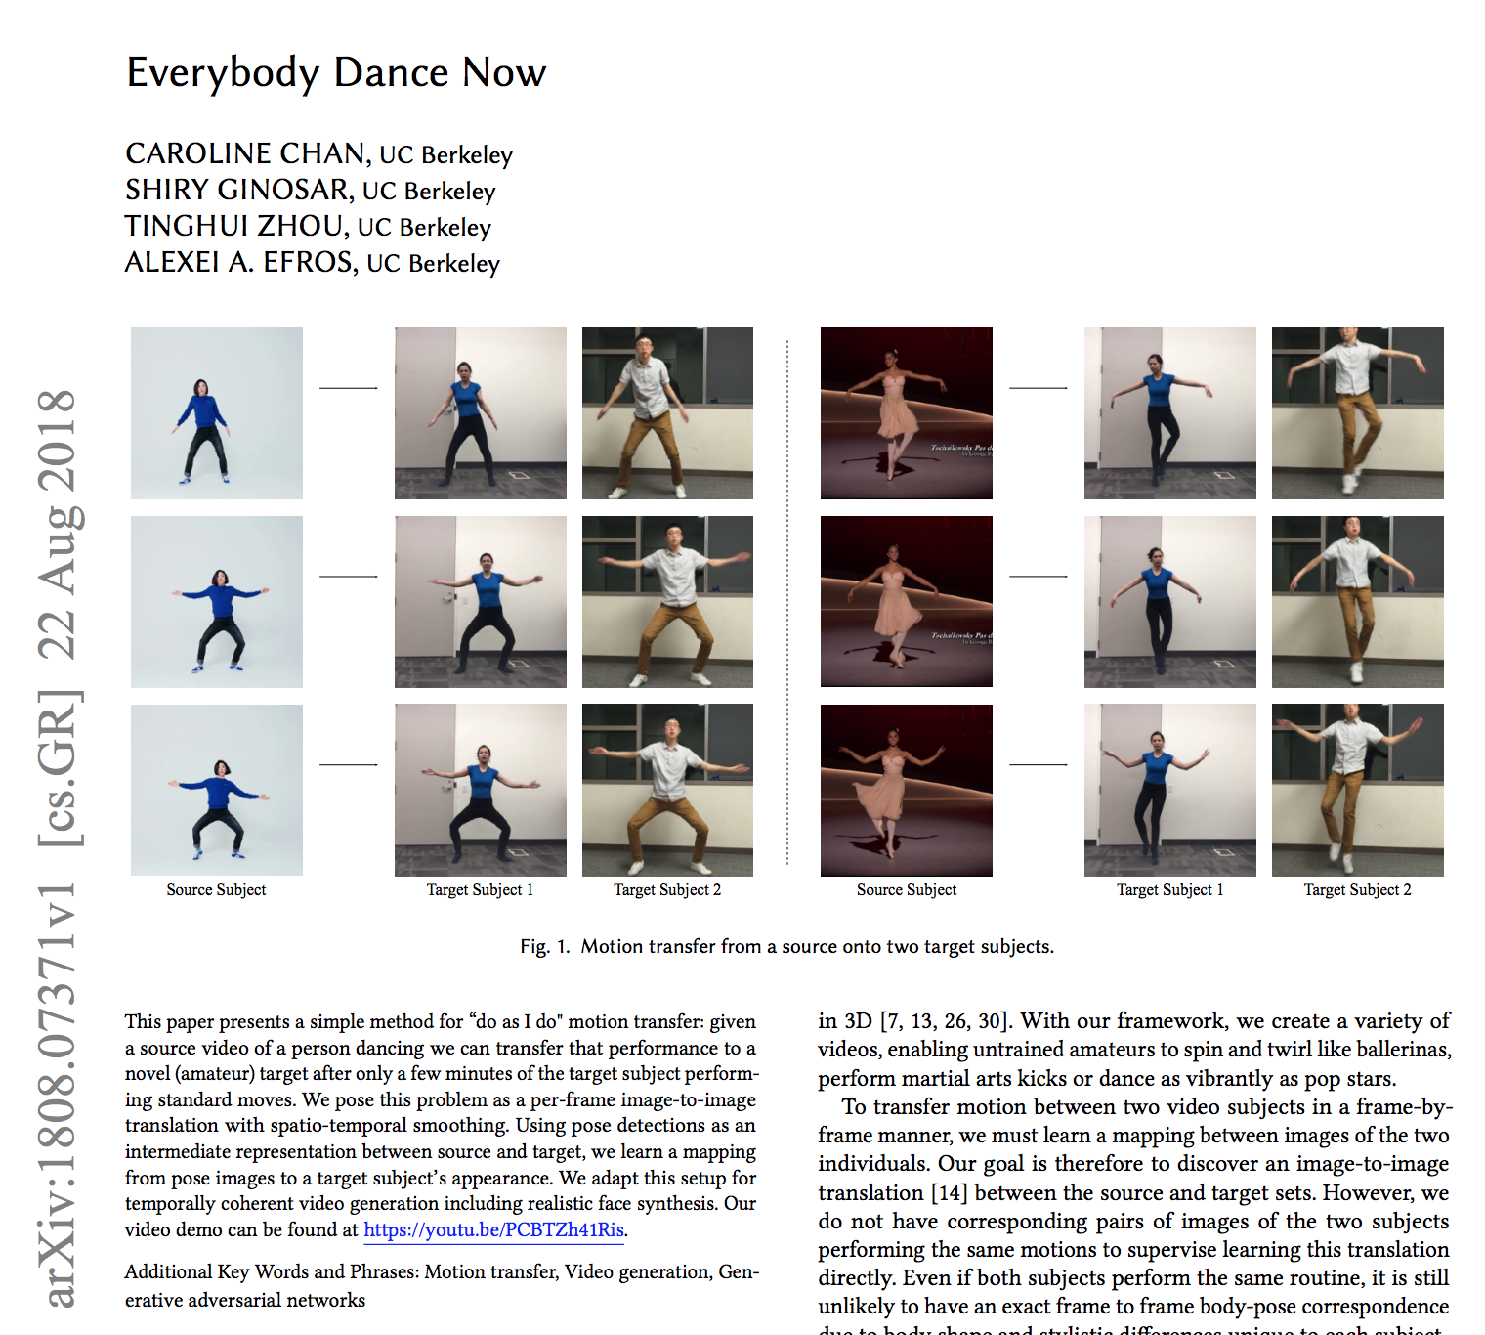
POSENET
In May 2018 the Google Creative Lab released a tensorflow.js version of PoseNet (see blog post). PoseNet is a convolutional neural network which in essence extracts the x/y coordinates of body parts from an input picture or video.
PoseNet
Video
Wireframe
…and this is how it looks:
We did a form of transfer learning by building our gesture detection model on top of the PoseNet output, i.e. the body part coordinates.
Despite PoseNet being relatively new there are already a few very interesting research papers available, e.g. for live video adaptation.

Slide 13
Agenda
1 |
Flying Drones With Gestures
2 |
System Components
3 |
Data And Prediction Model
4 |
Live Demo
5 |
Conclusion

Slide 14





We had to overcome several challenges:
MUCH MORE THAN A STANDALONE MACHINE LEARNING MODEL
Real-time Requirements
Python | JavaScript | Hardware
Needs to Work Offline
Flying a drone means every millisecond counts – or we crash into a wall. The model and data pipes therefore need to be stable and performant.
PoseNet runs in JavaScript. Training neural networks is much more mature in Python. Connecting to a drone API is needed. Bringing it all together is not simple.
A drone has its own wireless network. The native PoseNet runs on Google servers – we therefore had to make it run locally, including all libraries.

Slide 15





System Components
We use a webcam to record gestures from users in real-time.
PoseNet runs on a local node.js server and is exposed via a website. It translates a video stream into a wireframe stream.
A Python websocket server consumes the wireframe stream and feeds it into a gesture model. This model extracts movements like take-off or left from the wireframe stream.
A steering module connect the drone API with the movement stream from the gesture model and ensures multi-threading and realtime movements.
PoseNet
Gesture Detection
Steering Module
Client in Chrome
Video
Server
Server
Steering Module
Wireframe
Movements

Slide 16
Agenda
1 |
Flying Drones With Gestures
2 |
System Components
3 |
Data And Prediction Model
4 |
Live Demo
5 |
Conclusion

Slide 17
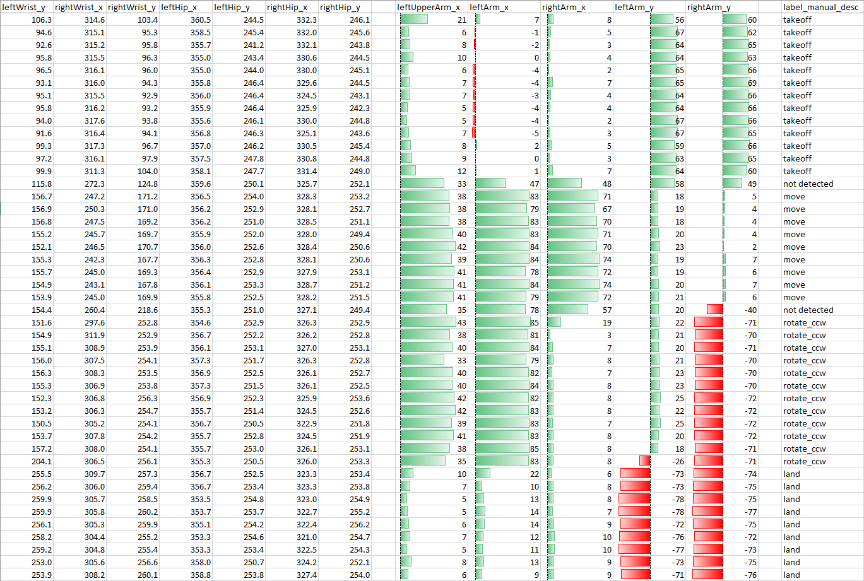
Starting WiTh (Static) Postures
A Soft Start…
Static postures are much easier to generate, label and predict. We thus started a prototype with simple postures like the ones below.
The Data
PoseNet streams the x/y coordinates of body parts. We used these to easily label movements. We do not need to care about the duration between points in the stream or their sequential order.

Slide 18
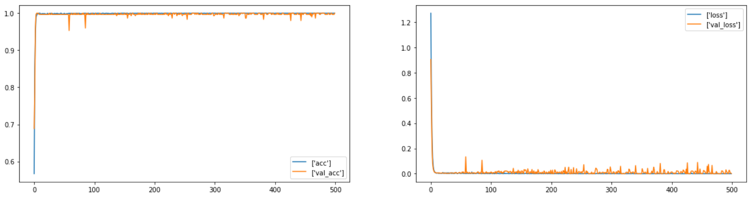
Starting WiTh (Static) Postures
Using a Neural Network for Postures
We used a fully connected neural network to detect postures. As expected, the model detected postures almost perfectly (see accuracy plot).
Using a neural network for postures feels like using a sledgehammer for cracking a nut. We did not tune the model further and started with gestures.
What Did we Learn?
We set up the data preparation pipelines properly
We got a feeling that gestures actually might work
We had a model that helped us connecting the other components
But now: let’s see how we approached the more interesting part of dynamic gestures!

Slide 19
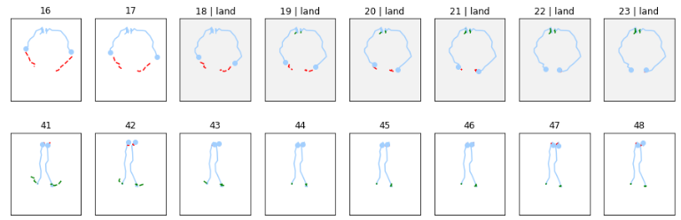
Labelling
PoseNet
Client in Chrome
t
Video
video clip of two seconds
Server
Wireframe
t
0
1
2
3
4
5
6
7
8
9
Second Try: Frame-Based Labelling
First Try: Time-Based Labelling
gesture start
gesture end
gesture start
gesture end
We looked at frame sets one by one and labelled them, with no regard for the actual time. For this we needed to visualize a video clip in a picture.
Here we see the position of the left and right wrist over time; grey means labelled.
video
video
0
1
2
3
4
5
6
7
We noted down start and end of a gesture in the video and applied this to the frames of the stream.
t
0
1
2
3
4
5
6
7
t
We struggled with two issues:
Stream speed variations made allocation of frames to point in time difficult
Even overall length of stream did not match the video length
label groups within gesture time taken from video
labelling
assumption
frequency of labels depends on CPU and stream speed is not constant
reality
Legend: current position 17 previous frames
5 frames before movement 5 frames after movement

Slide 20
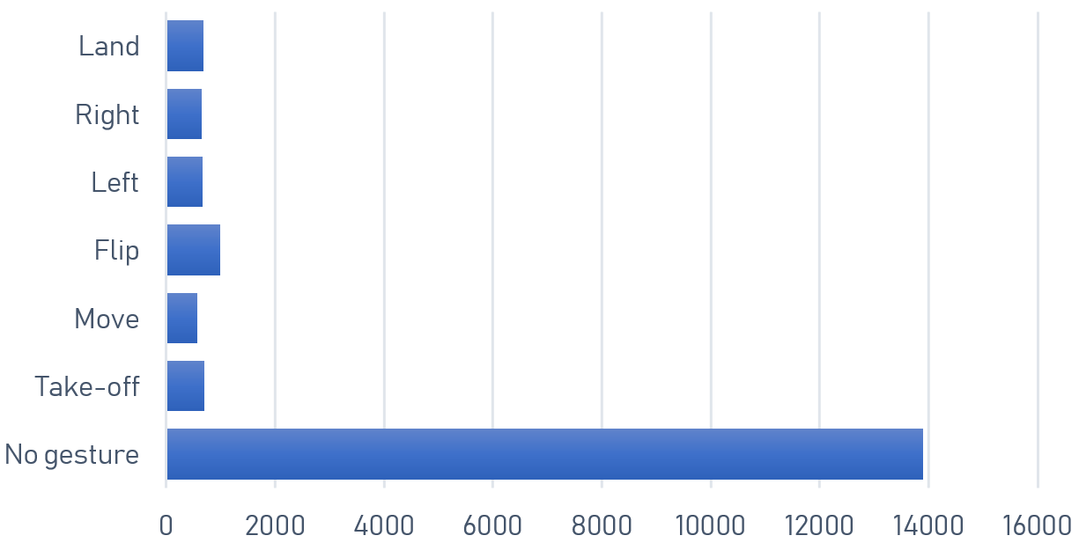
Data Improvement 1 / 2
1
Interpolation
2
Up- / Downsampling
PoseNet sends coordinates with changing intervals. We though interpolating them makes it easier for the model.
We had unbalanced data: ~75% of our data was labelled as ‘no gesture’.
t
Interpolation with cubic splines
t
While the theoretical accuracy increased we did not notice any improvement in practical tests with live streaming data.
We downsampled the ‘no gesture’ data by removing ambiguous ones
We upsampled the other data using replacement sampling
Sampling improved our accuracy noticeably
We decided to not use interpolation to reduce complexity

Slide 21
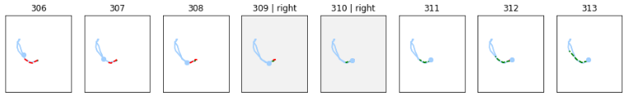
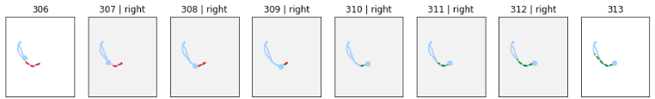
Data Improvement 2 / 2
3
Centralizing / Scaling
4
Tolerance range adaptation
PoseNet returns absolute coordinates. As the subject moves around, the measurements differ. We thus centralized and scaled the coordinates.
We labelled movements exactly. The result was that the model required very precise inputs. We relaxed the requirement and added a tolerance range.
Tolerance range = 0
Tolerance range = 2
Legend: current position 17 previous frames
5 frames before movement 5 frames after movement
Normalization proved to be the single most effective data improvement
Substantial impact on model performance

Slide 22
Model Selection
1
Random Forest
Usually robust, generalize well and do not need a lot of hyperparameter tuning.
Candidate for baseline classifier
Test Accuracy: 0.95
2
Support Vector Machine
Known to work well for classification tasks when there is not a lot of data
Test Accuracy: 0.93
3
Long Short-Term Memory (LSTM)
Type of recurrent neural network (RNN) that can store past information
Suited for sequence classification
Test Accuracy: 0.97
In theory all our models achieved high accuracy. However, this did not automatically translate to high accuracy on classifying live streaming data.

Slide 23
Agenda
1 |
Flying Drones With Gestures
2 |
System Components
3 |
Data And Prediction Model
4 |
Live Demo
5 |
Conclusion

Slide 24
Let us Fly.
A live demo with our Tello drone.

Slide 25
Agenda
1 |
Flying Drones With Gestures
2 |
System Components
3 |
Data And Prediction Model
4 |
Live Demo
5 |
Conclusion

Slide 26
CONCLUSION
We implemented a minimum viable product in the field of gesture recognition
We used transfer learning by building on top of PoseNet
Using PoseNet outcomes we build our own machinery for data acquisition
We used several feature engineering techniques to compensate for lack of data
We achieved a high theoretical accuracy ~ 97 %

Slide 27

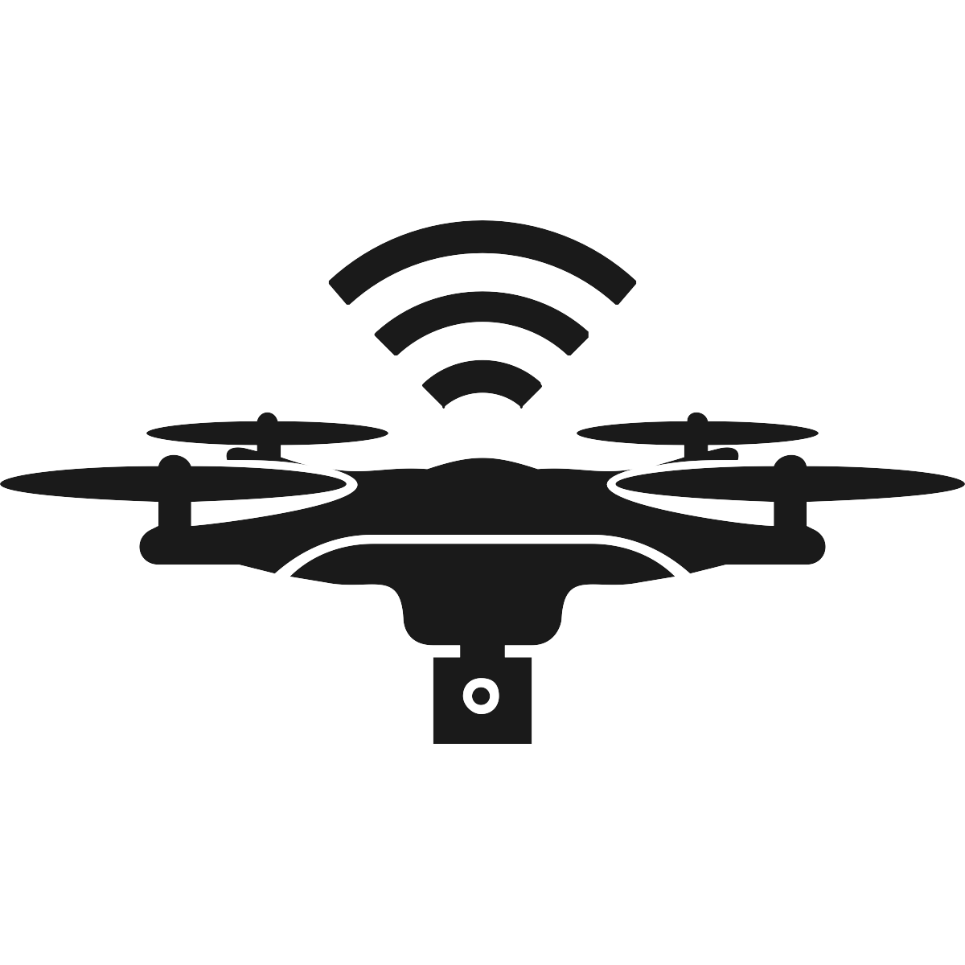

Possible Improvements and Next Steps
Data
Collect more (and more representative) training data
Train more complex and different length gestures
Use data augmentation for time series¹
Extract wireframes several times for a given video
Drone
Use advanced drone
Capture video signal directly from drone
Performance
Use better hardware
Optimize runtime performance for live prediction
Use more sophisticated model²
1 Data augmentation using synthetic data for time series classification with deep residual networks [arXiv:1808.02455v1 [cs.CV] 7 Aug 2018]
2 LSTM Fully Convolutional Networks for Time Series Classification

Slide 28



Potential for Commercialization
Search & Rescue
Toys
Camera Drones

Slide 29
Questions?

